Slide 1
Everything you ever wanted to know before you use and/or deploy UCLP on your advanced network or (simply)
UCLP demonstrations…
Hervé Guy (herve.guy@canarie.ca)
CANARIE's 10th Annual Advanced Networks Workshop
Halifax; Tuesday, November 23, 2004

Slide 2
Table of contents
Purpose
UCLP Software
  CANARIE's Directed Research program (4 versions funded)
  Documentations
  Training and support activities
  Definitions and examples
Environment Deployments
  UCLP lab. (Canada:CANARIE + CRC; Taiwan: NCHC)
  CA*net 4
Demonstrations
  UCLP Software
    University of Waterloo v1.4
    University of Ottawa - Communications Research Centre (CRC) v1.2
    Université du Québec à Montréal (UQAM) v1.0
  TL1 LightPath Proxy v1.3

Slide 3
UCLP Software
CANARIE's Directed Research Program
Co-funded by Cisco Canada and CANARIE (http://www.canarie.ca/funding/research/projects.html)
Held in 2003.
10 proposals submitted
3 selected
    University of Waterloo (http://bbcr.uwaterloo.ca/~canarie/index.htm)
    University of Ottawa - Communications Research Centre (CRC) (http://phi.badlab.crc.ca/uclp/)
    Carleton University (http://lightpath.physics.carleton.ca/)
+ 1 bonus
    Université du Québec à Montréal (UQAM) (http://www.teleinfo.uqam.ca/opticnet/)

Slide 4
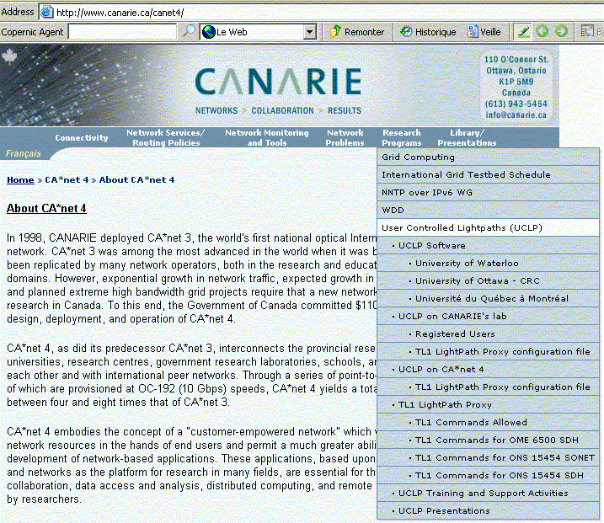
UCLP Software
Documentations
http://www.canarie.ca/canet4/;
  uclp/...

Slide 5
UCLP Software
Training and support activities
Past
  Internet 2; Ottawa CA, September 20-21, 2004
  NCHC; Tainan TW, October 11-12,2004
  BCnet; Vancouver CA, October 14-15,2004
Future
  SURFnet (via VC), December 1, 2004
  NETERA (next week)
  19th APAN Meetings in Bangkok, January 27, 2005
  Etc.

Slide 6
UCLP Software
Lightpath Definition
According to “User controlled Lightpath Definition Document (http://www.canarie.ca/canet4/library/c4design/user_controlled_definition.ppt)”, created by Bill St. Arnaud in December 2002:
  Any uni- or bi-directional point to point connection with effective guaranteed bandwidth
  Examples of LightPaths:
    STS channel on a SONET or SDH circuit
    Etc.

Slide 7
UCLP Software (example 1)
Simplest Working LightPath Object
Management Domain A
Management Domain B
LightPath

Slide 8

UCLP Software (example 2)
LightPath Object across a cloud
Management Domain A
Management Domain B

Slide 9
UCLP Software (example 3)
Concatenated LightPath Object
Management Domain B
Management Domain A
Management Domain C

Slide 10
UCLP Software (example 4)
Inherited LightPath Object
Management Domain A
Management Domain C
Management Domain B

Slide 11
Environment Deployments
UCLP lab. (http://www.canarie.ca/canet4/uclp/uclponlab.html)
UCLP deployed:
  University of Waterloo v1.4 (https://uclp04.canet4.net/web-uclp/).
  University of Ottawa - Communications Research Centre (CRC) v1.2 (federation canarielab: http://uclp02.canet4.net:6660/demo.jnlp).
  Université du Québec à Montréal (UQAM) v1.0.
Advantage! You can log in as an administrative or normal user.
Direct Telnet access to the Network Elements (NEs) or via the TL1 LightPath Proxy 1.3.
Only registered source IP addresses will be permitted to connect to the lab. Requests are to be sent to eng@canarie.ca.
Registered UCLP lab users (http://www.canarie.ca/canet4/uclp/uclplabusers.html)

Slide 12
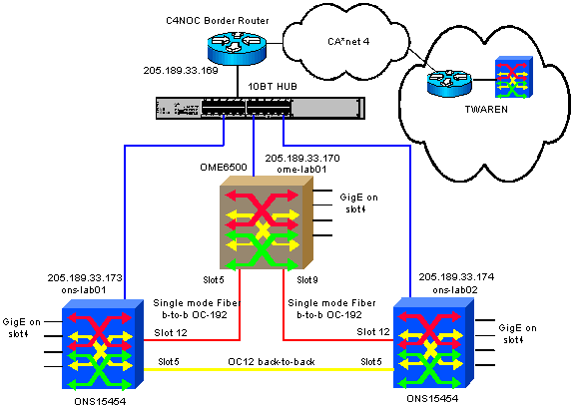
Environment Deployments
UCLP lab. (Architecture)

Slide 13
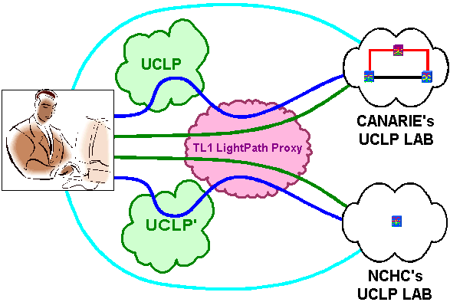
Environment Deployments
UCLP lab.
How to access it?

Slide 14
Environment Deployments
UCLP on CA*net 4. (http://www.canarie.ca/canet4/uclp/uclponc4.html)
For ease of management of lightpath on CA*net 4, a user must comply with CANARIE's Lightpath Allocation Policy and must fill out CANARIE's Lightpath Request Form.
Only registered source IP addresses will be permitted to connect to the lab. Requests are to be sent to eng@canarie.ca.
UCLP deployed:
  University of Waterloo v1.4: https://uclp01.canet4.net/web-uclp/.
  University of Ottawa - Communications Research Centre (CRC) v1.2
    Federation c4west: http://uclp02.canet4.net:4445/demo.jnlp;
    Federation c4 central: http://uclp02.canet4.net:5550/demo.jnlp;
    Federation c4east: http://uclp02.canet4.net:7777/demo.jnlp.
  Université du Québec à Montréal (UQAM) v1.0.
Log in as a normal user. C4NOC are administrative users.

Slide 15
Environment Deployments
UCLP on CA*net 4. (http://www.canarie.ca/canet4/uclp/uclponc4.html)
Registered UCLP on CA*net 4 users
  International
    Internet 2;
    HEAnet;
    TANet 2;
    KREOnet2;
  ORAN
    ORION;
    BCnet;
    NETERA;

Slide 16
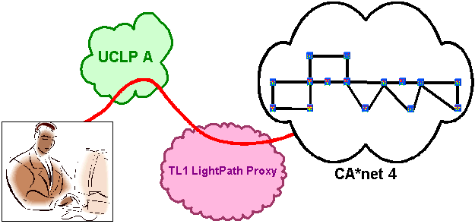
Environment Deployments
UCLP on CA*net 4
How to access it?

Slide 17
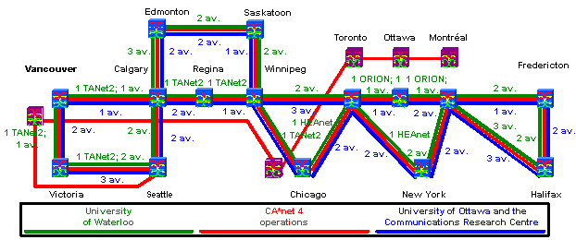
Environment Deployments
UCLP on CA*net 4
LightPath allocations

Slide 18
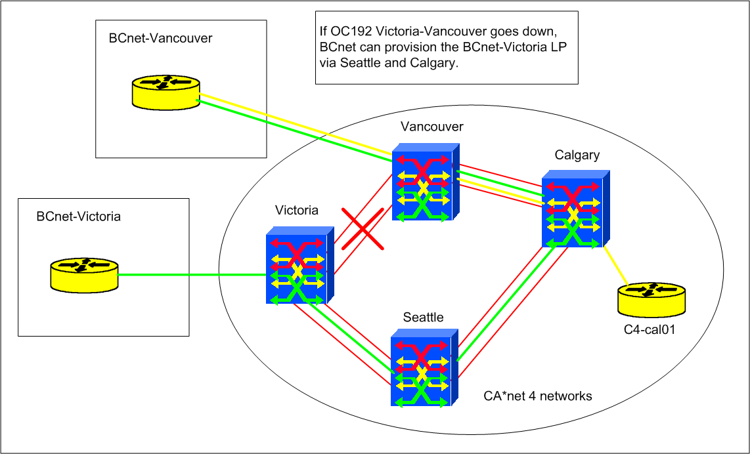
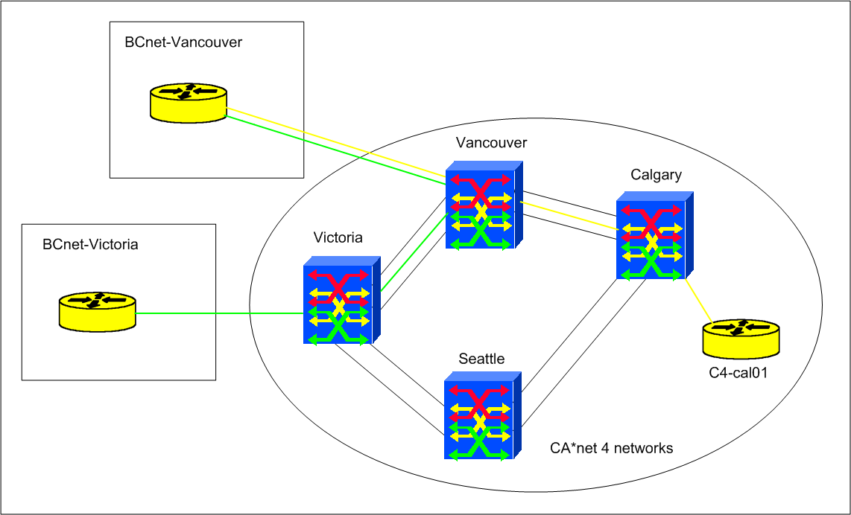
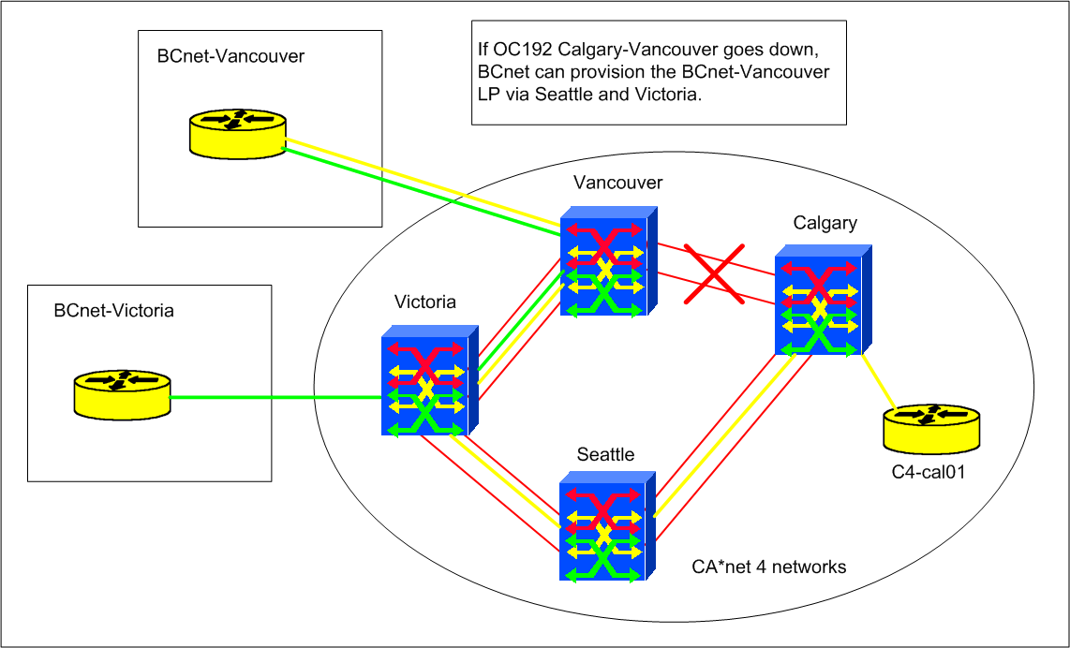
UCLP on CA*net 4
User: BCnet

Slide 19
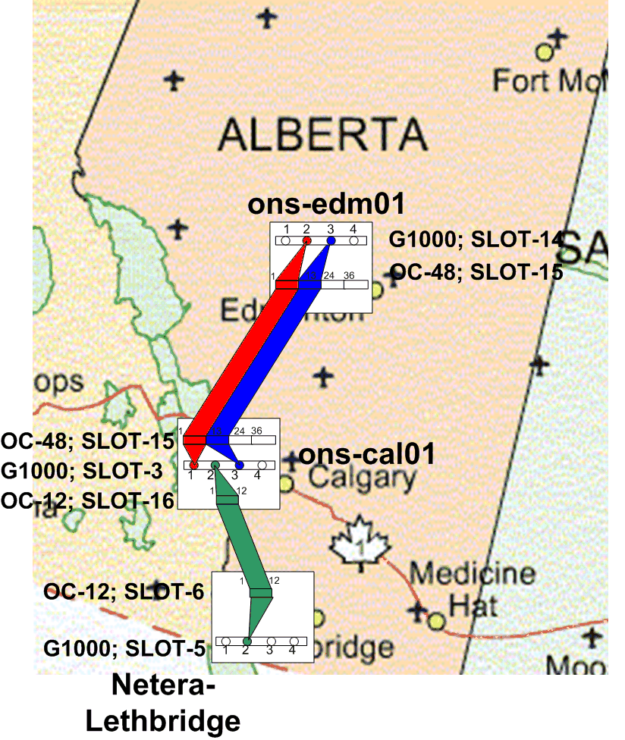
UCLP on CA*net 4
User: NETERA

Slide 20
Environment Deployments
TL1 LightPath Proxy v1.3
Documentations
Created by Monfox (http://www.monfox.com/dtl1_lpproxy.html); contact: Stefan King (sking@monfox.com).
TL1 LightPath Proxy Web page (http://www.canarie.ca/canet4/uclp/tl1lightpathproxy.html).
Encrypted TL1 LightPath Proxy configuration file for CA*net 4 (http://www.canarie.ca/canet4/uclp/tl1lightpathproxyconfigurationfileonc4.html).
Encrypted TL1 LightPath Proxy configuration file for UCLP lab. (http://www.canarie.ca/canet4/uclp/tl1lightpathproxyconfigurationfileonlab.html).
Supports now Cisco ONS 15454 SONET (R4.1) and SDH (R4.7), Nortel OME 6500 SDH (R1.0).
Should support Nortel OPTera Metro 5200 (R3.1) and Meriton 7200 OADX and 3300 OSU soon.

Slide 21
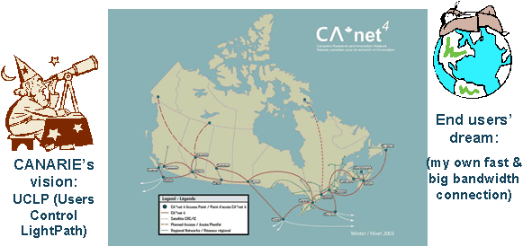
Environment Deployments
TL1 LightPath Proxy v1.3
CANARIE’s VISION

Slide 22
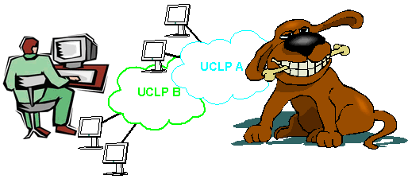
Environment Deployments
TL1 LightPath Proxy v1.3
Concerns, Issues…

Slide 23
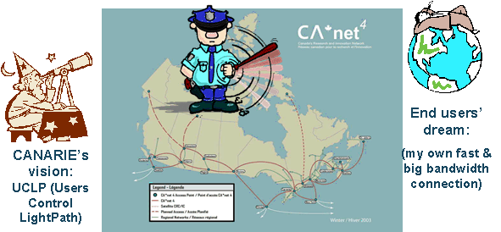
Environment Deployments
TL1 LightPath Proxy v1.3
Solution

Slide 24
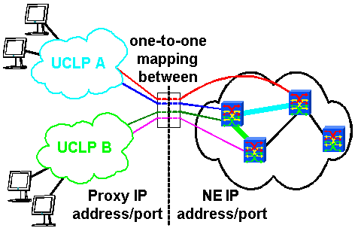
Environment Deployments
TL1 LightPath Proxy v1.3
How does it work?

Slide 25
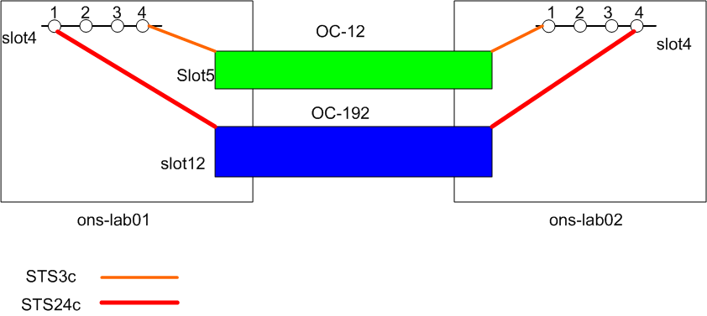
UCLP Demonstrations on lab.

Slide 26
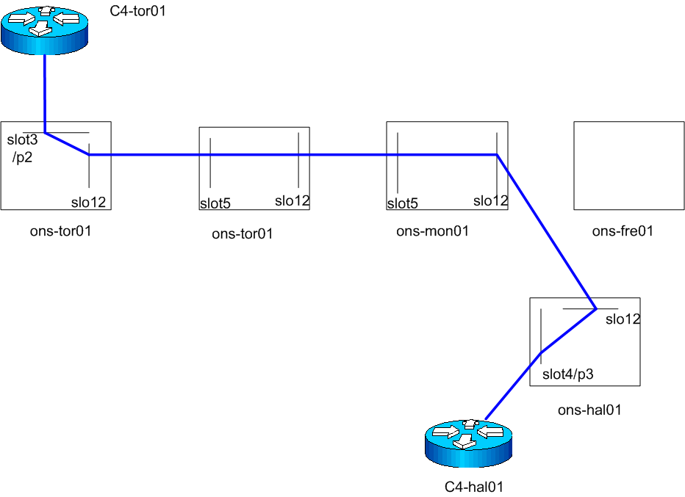
UCLP Demonstrations on CA*net 4

Slide 27
UCLP Demonstrations
University of Waterloo v1.4
Documentations
University of Waterloo; School of Computer Science;
Project leader: Raouf Boutaba, Ph.D.
  rboutaba@bbcr.uwaterloo.ca
University of Waterloo’s URL
  http://www.canarie.ca/canet4/uclp/waterloo/uclpwaterloo.html
CANARIE’s URL
  http://www.canarie.ca/canet4/uclp/waterloo/uclpwaterloo.html

Slide 28
UCLP Demonstrations
University of Waterloo v1.4
Definitions (1/2)
A Lightpath Object (LPO) is an abstract representation of a lightpath owned and controlled by a single user.
A root LPO is created by an administrator and represents a lightpath between two physically adjacent cross-connect devices.
Only the current owner the of a lightpath can execute operations on it.
  Advertisement functions enable users to make their lightpath available to other users up to a specific point in time.
  Lease LPO functionality involves taking ownership of an LPO, which permits to a new user to execute operations on it.
  Accessing an LPO refers to the process of preparing it for routing traffic. The Access function is used to cross-connect the endpoints of a lightpath to Ethernet ports.

Slide 29


UCLP Demonstrations
University of Waterloo v1.4
Definitions (2/2)
LPO partitioning refers to the process of distributing the bandwidth of a parent lightpath into several smaller child lightpaths.
LPO concatenation refers to the process of composing multiple constituent lightpaths of common bandwidth into a single compound lightpath that has the bandwidth but extends from the source of the first constituent to the destination of the last constituent.

Slide 30
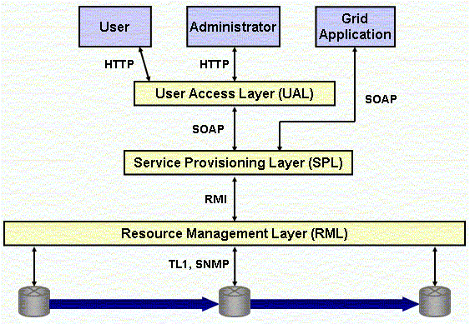
UCLP Demonstrations
University of Waterloo v1.4
Architecture

Slide 31

UCLP Demonstrations
University of Waterloo v1.4
User Access Layer (UAL)
HTTP
Web Interface
Tomcat Web Server
Request
Handler
SOAP
User Access Layer
Service Provisioning Layer

Slide 32
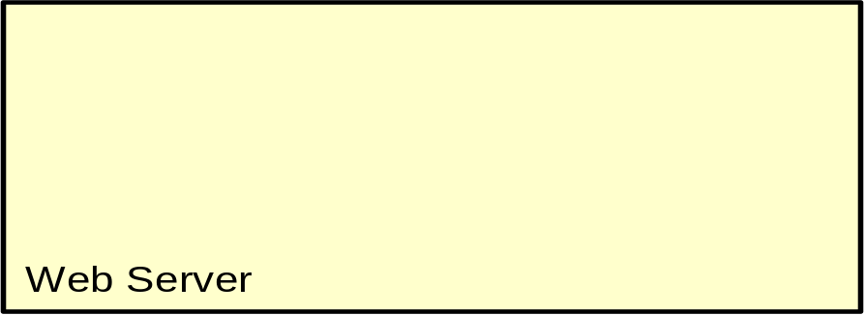
UCLP Demonstrations
University of Waterloo v1.4
Service Provisioning Layer (SPL)
Grid Application
User Access Layer
SOAP
Grid Service Interface
JBoss J2EE application server
Globus Toolkit 3 Grid Hosting Environment
LPO Service EJB Home
LPO Grid Service
LPO Factory
Service
LPO Service Implemen-
tation
LPO Delegate Service
RMI
LPO Service EJB Remote
JDBC
Legend
Create service
Access service
RMI
MySQL
SPL
Resource Management Layer

Slide 33
UCLP Demonstrations
University of Waterloo v1.4
Resource Management Layer (RML)
RMI
Service Provisioning Layer
Resource Management Layer
Resource Agent
Request Controller
LPO Controller
LPO Controller
LPO Controller
LPO Controller
LPO
Space
Programmable Controller
LPO Controller
Switch Interface
TL1, SNMP

Slide 34
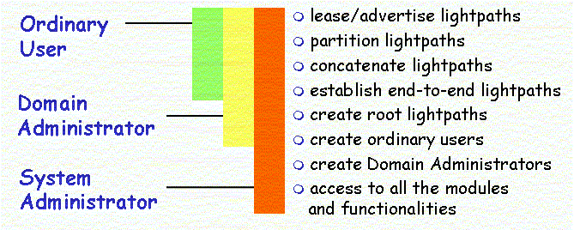
UCLP Demonstrations
University of Waterloo v1.4
Users and Privileges

Slide 35
UCLP Demonstrations
University of Waterloo v1.4
Users and Functionalities
System administrator
  creating domain;
  configuring e-mail;
System administrator or domain administrator
  cleaning agents;
  adding user;
  creating root LPOs
    accessing root LPOs
    partitioning created root LPOs
      concatenating partitioned LPOs
      accessing partitioned or concatenated LPOs
      advertising partitioned or concatenated LPOs
    alternatively, using End-to-End LPOs process
Ordinary user
  modifying user Profile
  leasing advertised LPOs
    accessing leased LPOs
    partitioning or concatenating leased LPOs
      accessing partitioned or concatenated LPOs
      advertising partitioned or concatenated LPOs
  alternatively, using End-to-End LPOs process

Slide 36
UCLP Demonstrations
University of Waterloo 1.4
On UCLP lab (https://uclp04.canet4.net/web-uclp/).
  As administrative user (Create, Partition, Advertise LPOs).
  As normal User (Lease and Access LPOs).
On CA*net 4 (https://uclp01.canet4.net/web-uclp).
  As normal User, Lease and Access the following LPOs:
    ons-tor01<=> ons-ott01<=> ons-mon01<=> ons-fre01<=> ons-hal01
    ons-tor01<=> ons-ott01<=> ons-mon01<=> ons-hal01
  Check E2E connectivity via CA*net 4 Routers Looking Glass (http://dooka.canet4.net/lg/lg.php)

Slide 37


UCLP Demonstrations
University of Ottawa - CRC v1.2
Documentations
University of Ottawa
  School of Information Technology and Engineering (SITE) (http://www.site.uottawa.ca/)
  Co-project leader: Gregor v. Bochmann (bochmann@site.uottawa.ca)
University of Ottawa - Communications Research Centre
  Broadband Applications and Demonstration Laboratory (BADLAB) (http://www.crc.ca/en/html/crc/home/research/network/system_apps/badlab/badlab)
  Co-project leader: Michel Savoie (michel.savoie@crc.ca)
Project URL: http://phi.badlab.crc.ca/uclp/.
CANARIE URL: http://www.canarie.ca/canet4/uclp/waterloo/uclpwaterloo.html

Slide 38
UCLP Demonstrations
University of Ottawa - CRC v1.2
Definitions (1/2)
A federation is an independent management domain that has its own set of UCLP services.
The Federation Manager is one (or a cluster of) Lookup Service(s) that maintain a list of active UCLP Lookup Services.
The Grid Service Access Point (GSAP) provides two grid services for the administrators and users.
The Jini Service Access Point (JSAP) is a Jini service that acts as the access point to the other Jini services within the UCLP System
Lightpath Discovery and Provisioning Layer is the core UCLP services including the Optical Routing module of the JSAP, the LPOS, the Lease Manager, and the Jini utility services (Jini Lookup Service, JavaSpace and Transaction Manager).
The Switch Control Layer has a number of modules used to control the switches and manage the resources on the switches.

Slide 39
UCLP Demonstrations
University of Ottawa - CRC v1.2
Definitions (2/2)
LightPath Object (LPO) is an abstraction of one or more lightpaths with a set of attributes that represent a connection between two or more switches.
End-to-End Connection Object is an abstraction of an end-to-end connection in the UCLP System.
Resource Objects are an abstraction of the different physical resources that can be used depending on the switch hardware and technology. The subclasses of RO are:
  EndPointRO, it represents an add/drop facility on a switch.
    IPRO, a subclass of EndPointRO, it represents a gigabit Ethernet port using IP.
  PassthroughRO: it represents a resource that can be cross connected through the switch without being added or dropped, (i.e. a cross connection between two SONET ports on a switch)
    SONETRO: A subclass of PassthroughRO, it represents a SONET channel.

Slide 40
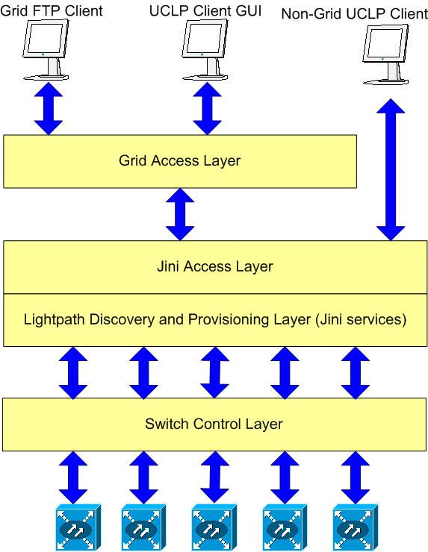
UCLP Demonstrations
University of Ottawa - CRC v1.2
Architecture (1/3)

Slide 41
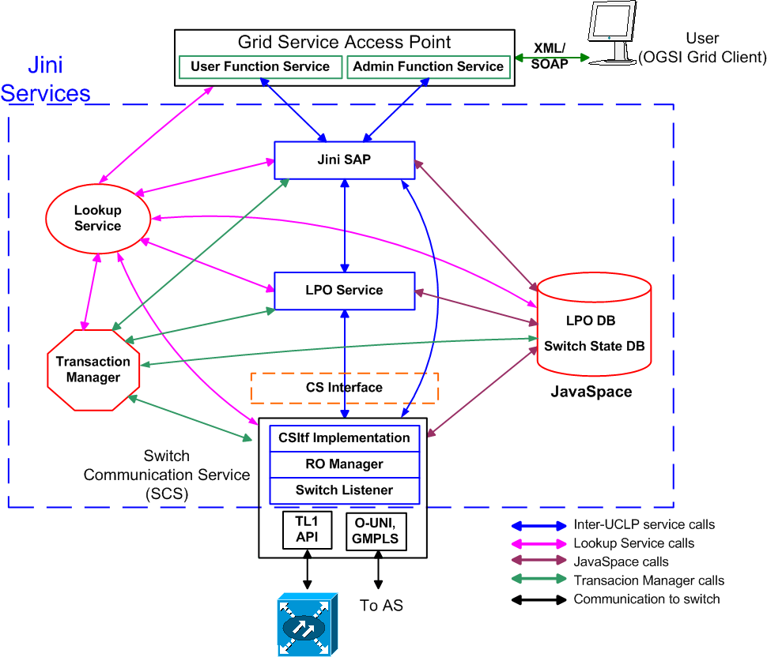
UCLP Demonstrations
University of Ottawa - CRC v1.2
GSAP(GRID) & JSAP(JINI) layers

Slide 42
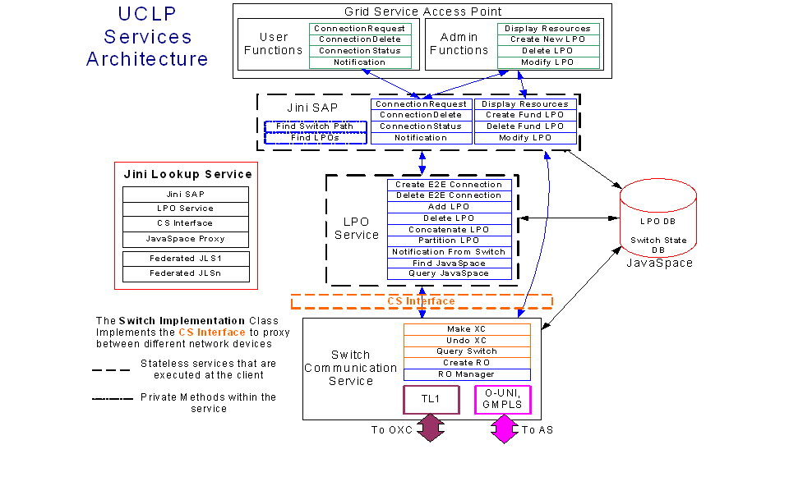
UCLP Demonstrations
University of Ottawa - CRC v1.2
Service architecture

Slide 43
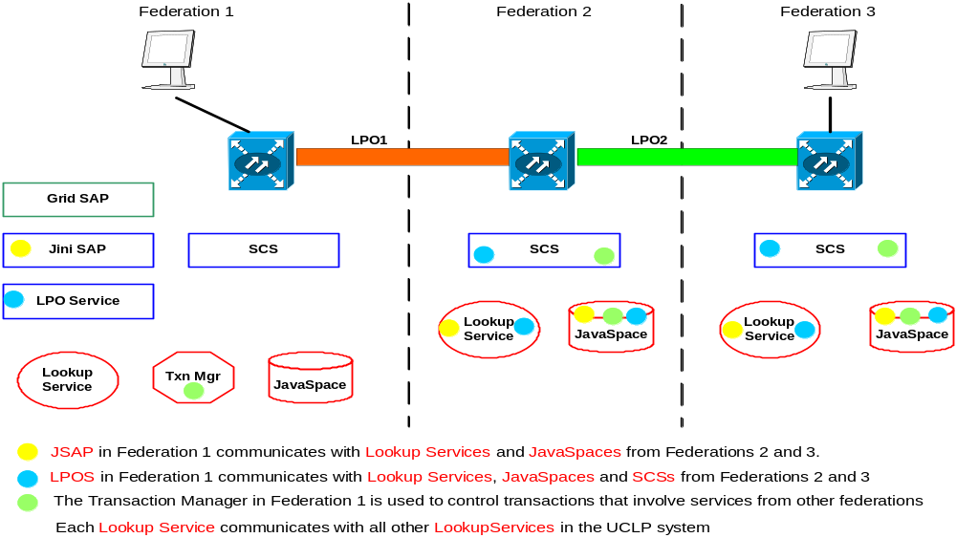
UCLP Demonstrations
University of Ottawa - CRC v1.2
Example using 3 Federations

Slide 44
UCLP Demonstrations
University of Ottawa - CRC v1.2
Users and Functionalities (1/2)
Administrative users
  LPO
    Create
    Query
      Delete
  RO
    Create
    Query
      Delete
  Switch
    Query
  User
    Add
    Query (Any User's Profile)
      Modify
      Delete

Slide 45
UCLP Demonstrations
University of Ottawa - CRC v1.2
Users and Functionalities (2/2)
Normal users
  E2E Connection
    Create
    Query
      Sublease
      Delete
  User
    Modify (his own password only)

Slide 46
UCLP Demonstrations
University of Ottawa - CRC v1.2
On UCLP lab
  Federation canarielab: http://uclp02.canet4.net:6660/demo.jnlp).
  As administrative user (Create EndPointRO –IPROs, PassthroughR) – SONETROs and LPOs).
  As normal User (Create E2E Connection LPOs).
On CA*net 4.
  Federation c4west: http://uclp02.canet4.net:4445/demo.jnlp;
  Federation c4 central: http://uclp02.canet4.net:5550/demo.jnlp;
  Federation c4east: http://uclp02.canet4.net:7777/demo.jnlp.
  As normal User, Create E2E Connection the following LPOs:
    ons-tor01<=> ons-ott01<=> ons-mon01<=> ons-fre01<=> ons-hal01
    ons-tor01<=> ons-ott01<=> ons-mon01<=> ons-hal01
  Check E2E connectivity via CA*net 4 Routers Looking Glass (http://dooka.canet4.net/lg/lg.php)

Slide 47
UCLP Demonstrations
Université du Québec à Montréal v1.0
Documentations
Université du Québec à Montréal (UQAM);
  Opticnet group (which is a part of Téléinfo Lab.)
Project leader: Omar Cherkaoui, Ph.D.
  cherkaoui.omar@uqam.ca
Université du Québec à Montréal’s URLs
  http://www.teleinfo.uqam.ca/english/projet_lightpath.htm
  http://www.teleinfo.uqam.ca/projet_lightpath.htm
CANARIE’s URL
  http://www.canarie.ca/canet4/uclp/uplauqam.html

Slide 48
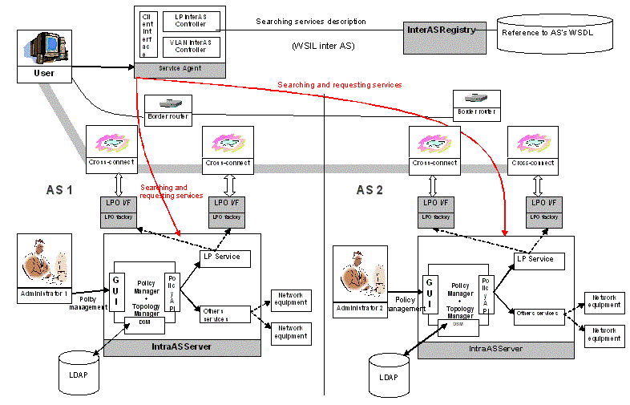
Université du Québec à Montréal v1.0
Architecture

Slide 49
UCLP Demonstrations
Université du Québec à Montréal v1.0
Modules (1/2)
Service Agent
  UCLP access point.
  Provide Lightpath operations (Search, Stop, modify, concatenate and partitioning)
  Ensure E2E lightpath service provisioning
  Notify users about E2E lightpath status changes.
  2 client Interfaces:
    GUI
    WSDL
InterASRegistry
  The Repository of the lightpath service providers URLs (WSIL).
  Provide WSDL interface.
IntraASServer
  Domain lightpath service access point.
  Provide operations to build intra domain lightpaths.
  Provide WSDL interface.

Slide 50
UCLP Demonstrations
Université du Québec à Montréal v1.0
Modules (2/2)
Policy Manager
  Manages the domain policies
  Ensure respecting authentication and authorization rules defined by domain administrator.
  Inventory.
  Policy Enforcement Tool.
  Provide WSDL Interface.
  Provide sub modules called topology Manager.
    Search routes between 2 interfaces.
LPServer
  Deploy/Undeploy cross connections.
  Manages used resources.
  Manages LPO.
ConsoleAdmin
  Enable administrators to configure UCLP Servers.
  Enable administrators to manage domain resources (block STS channels, Add rules, add policies …)
  2 interfaces :
    GUI.
    WSDL

Slide 51
UCLP Demonstrations
Université du Québec à Montréal v1.0
On UCLP lab
  As normal User creates LightPaths.
On CA*net 4
  As normal User creates the the following LightPath:
    ons-tor01<=> ons-ott01<=> ons-mon01<=> ons-hal01
  Check E2E connectivity via CA*net 4 Routers Looking Glass (http://dooka.canet4.net/lg/lg.php)

